Slide 1
Identifying pest-infected plants in farmlands.
Presented By :
BHOPAL P
ABHISHEK SURYAVANSHI
NAVEEN S
RAKESH GOWDA GM

Slide 2
Problem Statement
"To predict diseases on leaves of plant "

Slide 3
ABSTRACT
Plant disease prediction project focuses on identifying plant diseases using artificial intelligence (AI). By analyzing images of plant leaves, we aim to detect diseases early, which can help farmers protect their crops and improve yields. Our system uses CNN algorithms to accurately identify different plant diseases. The goal is to create a reliable and user-friendly tool that can be used in real-world farming to ensure healthier plants and better agricultural productivity.

Slide 4
Introduction
Plant diseases are a significant threat to agriculture, affecting crop yield, quality and farmers livelihoods. Early and accurate detection of plant diseases is essential for effective management and control, preventing widespread damage and ensuring food security.
With advancements in technology, artificial intelligence (AI) and machine learning (ML) offer promising solutions for automating and improving the accuracy of plant disease detection. By analyzing images of plant leaves, AI-based systems can identify disease symptoms early, enabling timely intervention and reducing crop losses.
This project explores the development of a plant disease detection system using AI. By leveraging image processing techniques and CNN algorithms, we aim to create a tool that can accurately classify various plant diseases from leaf images. The system will provide farmers with a reliable, easy-to-use solution for monitoring the health of their crops, ultimately contributing to increased agricultural productivity and sustainability.

Slide 5
Objectives
To identify the presence of infections.
To identify various diseases in plants.
To implement a method for preventing the diseases and providing management for reducing the losses/damages caused by diseases.

Slide 6
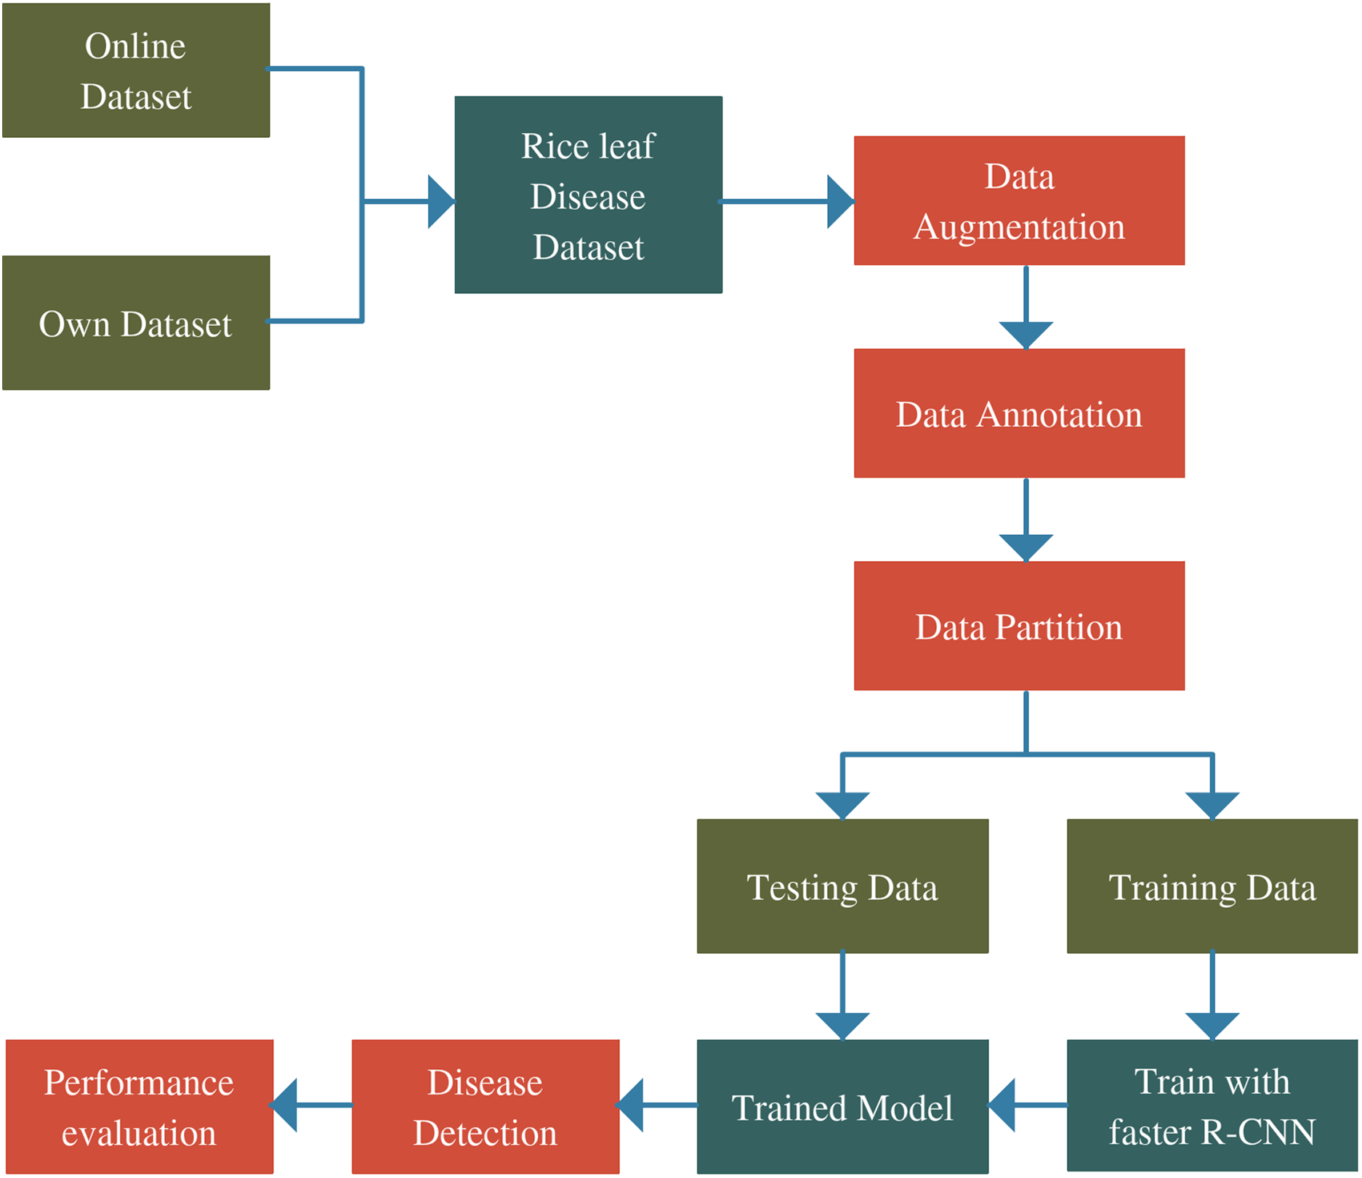
System Architecture

Slide 7
Methodology
1.Data Collection
Symptom Observation: Train farmers or field workers to recognize common symptoms of plant diseases (e.g., leaf spots, wilting).
Sensor Deployment: Use affordable sensors to gather data on environmental conditions (temperature, humidity) and plant health indicators (leaf color, moisture levels).
Mobile Apps: Develop user-friendly mobile apps for farmers to report symptoms and upload images of affected plants.
2.Data Preparation
Data Cleaning: Remove duplicates, handle missing values, and correct errors in collected data.
Feature Extraction: Extract relevant features from data sources (e.g., color features from images, statistical features from sensor data).

Slide 8
Methodology
3.Model Selection
Consider Pre-trained Models: Utilize pre-trained models for image classification tasks if dealing with image data (e.g.CNNs trained on plant disease image datasets).
4.Model Training and Evaluation
Training: Split data into training and validation sets. Train the selected model using the training data.
Evaluation: Assess the model’s performance using metrics like accuracy, precision, recall, and F1-score on the validation set.
5.Prediction and Deployment
Deploy the Model: Implement the trained model in a web or mobile application for real-time prediction.
Provide Recommendations: Offer actionable insights and recommendations to farmers based on predicted disease risks.

Slide 9
Methodology
6.Monitoring and Feedback
Monitor Performance: Continuously monitor the model’s accuracy and performance over time.
7.Iterative Improvement
Update Model: Periodically update the model with new data and insights to improve prediction capabilities.
Community Engagement: Engage with farmers and agricultural experts to refine the system based on their feedback and domain knowledge.

Slide 10
Implementation
This project uses a CONVOLUTIONAL NEURAL NETWORK(CNN) MODEL trained on the plantvillage dataset to classify images and identify common diseases.
The System is implemented as a web application that farmers can use to upload images of plant leaves.

Slide 11
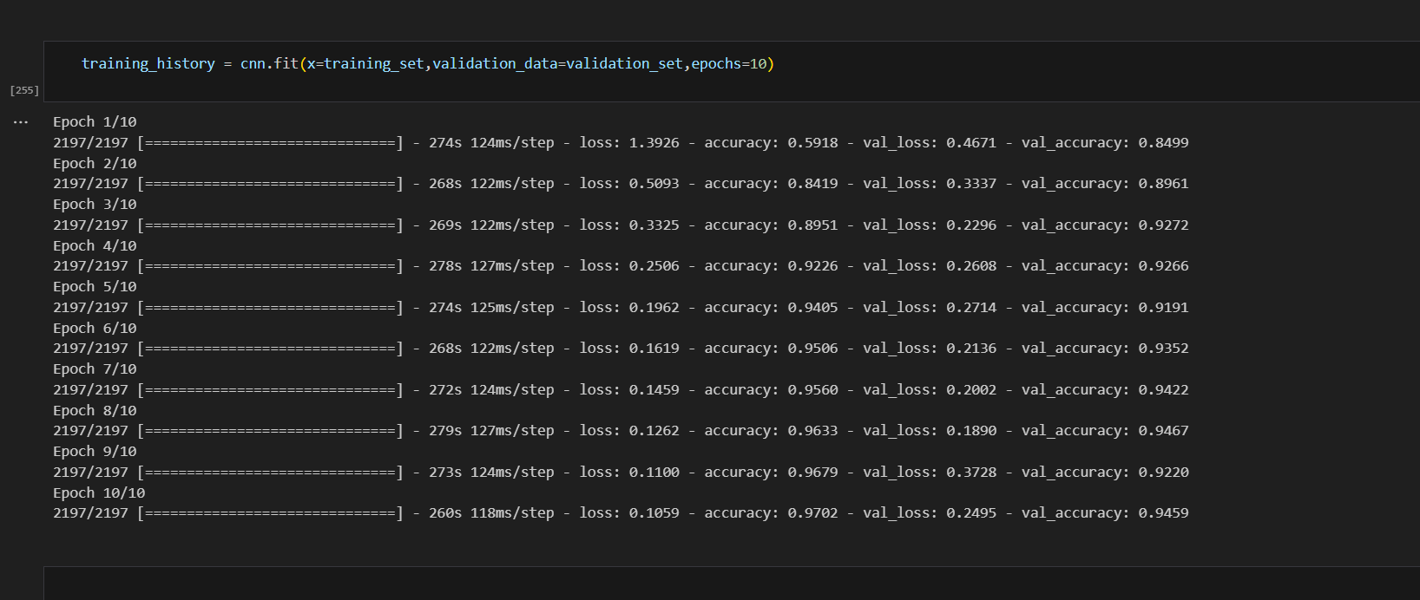
RESULTS

Slide 12
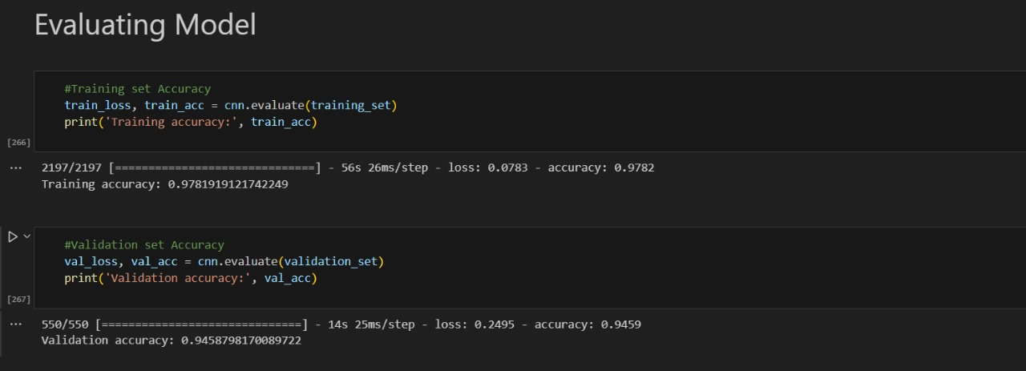

Slide 13
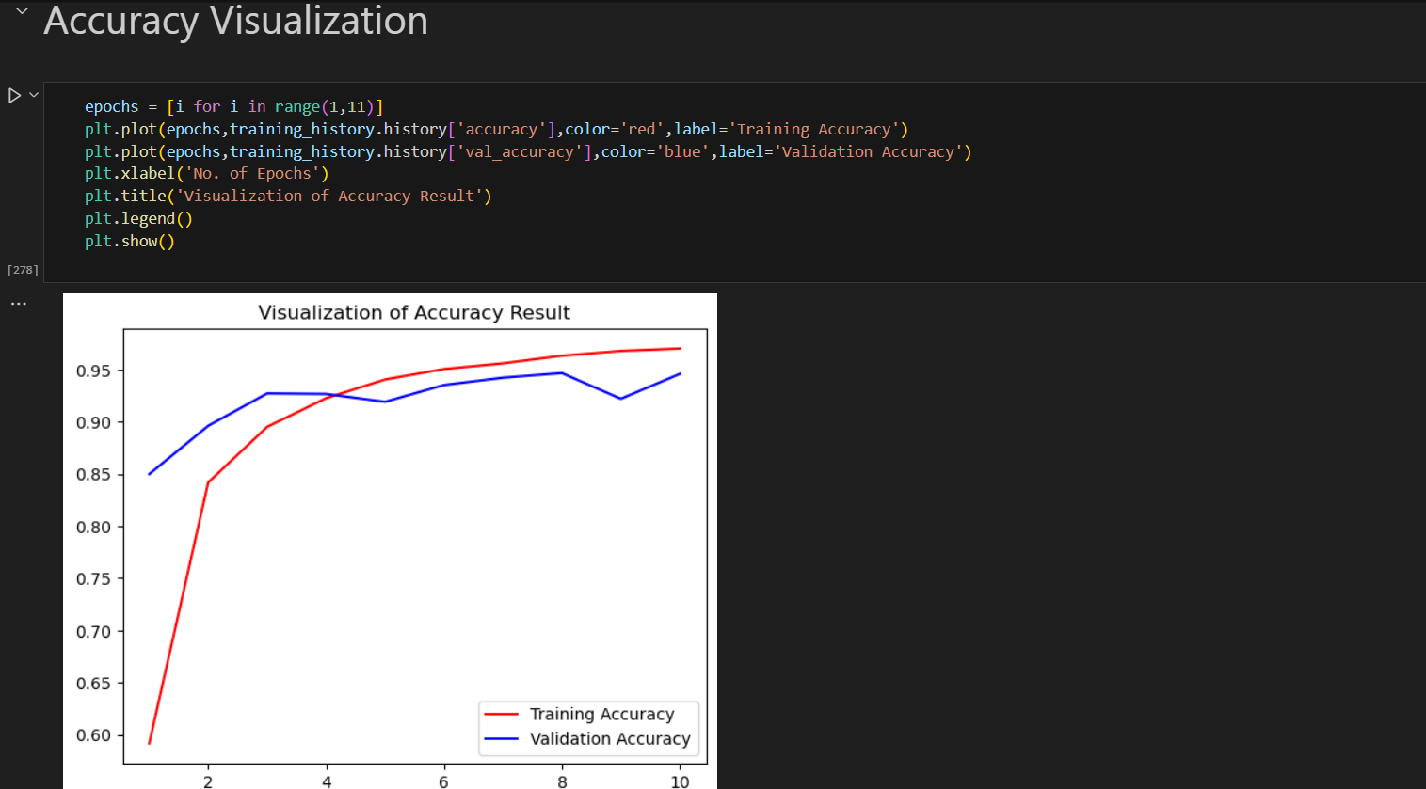

Slide 14
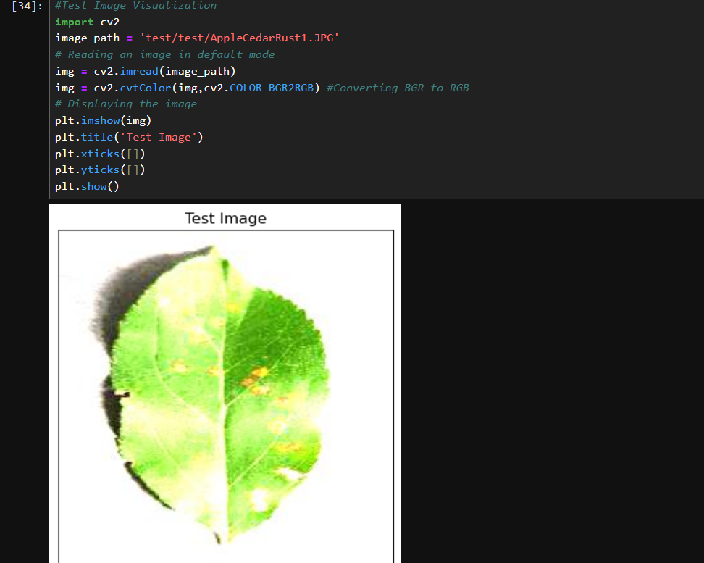
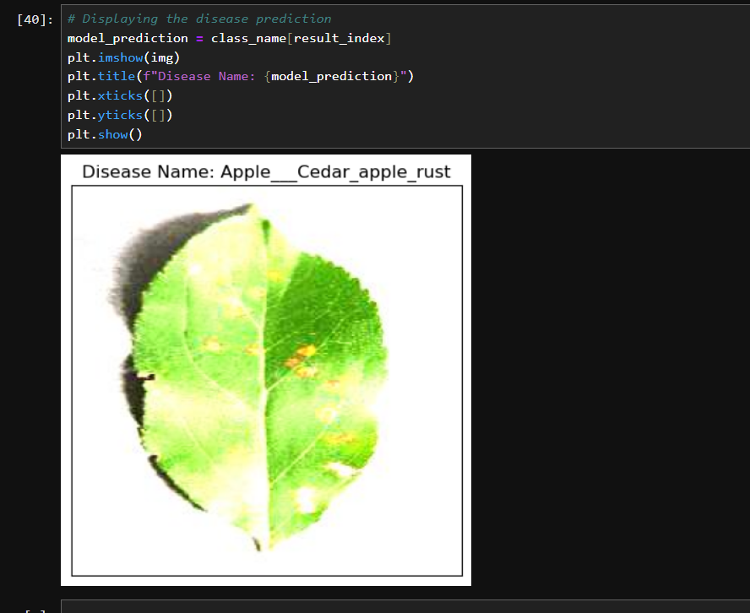

Slide 15
Evaluation Metrics
Accuracy:
Definition: The proportion of correctly predicted instances (both true positives and true negatives) out of the total number of instances.
Interpretation: Higher accuracy indicates better overall performance of the model in predicting both diseased and healthy plants correctly.
Precision:
Definition: The proportion of correctly predicted positive cases (diseased plants) out of all predicted positive cases.
Interpretation: Precision measures the reliability of positive predictions. A higher precision means fewer false positives, indicating fewer healthy plants incorrectly classified as diseased.

Slide 16
Conclusion
The application of ML and DL techniques in plant disease prediction is a rapidly evolving field with promising results.
These techniques have demonstrated their potential to accurately identify and classify plant diseases.
This study demonstrates the potential of CNNs for plant disease prediction.
The proposed CNN-based application is able to accurately predict the presence of diseases with high precision and recall,showing its potential as a powerful tool for plant disease detection.

Slide 17
THANK YOU

